Slide 1

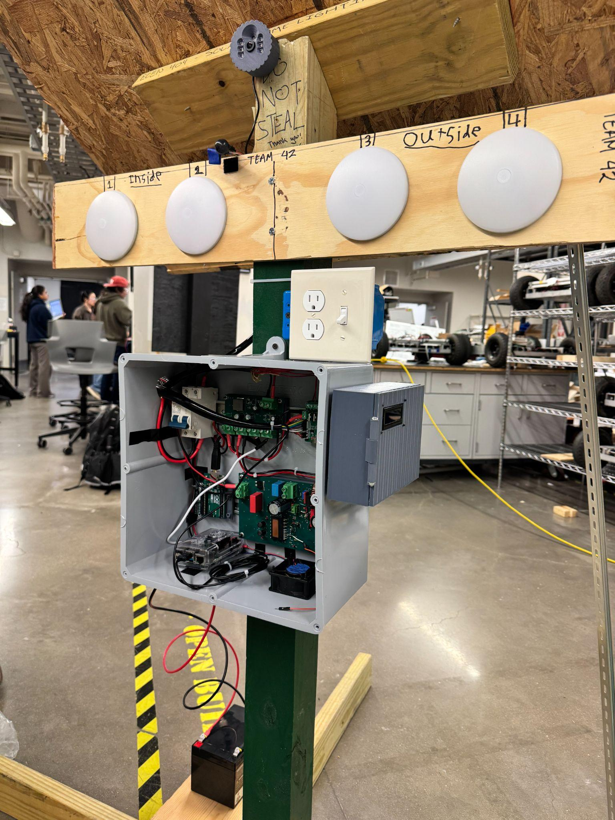
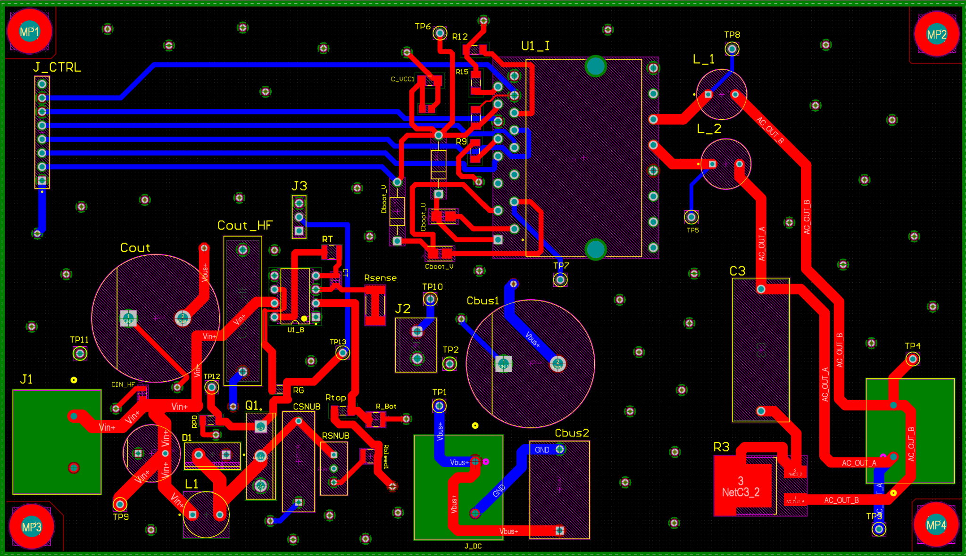
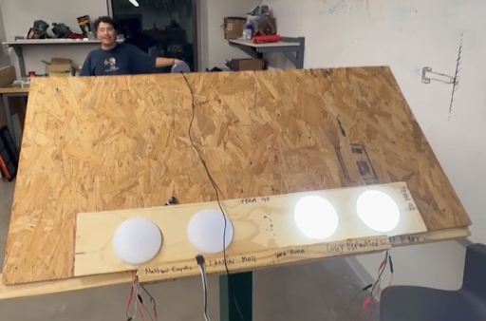
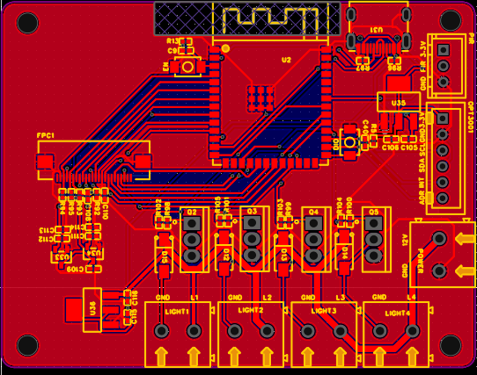
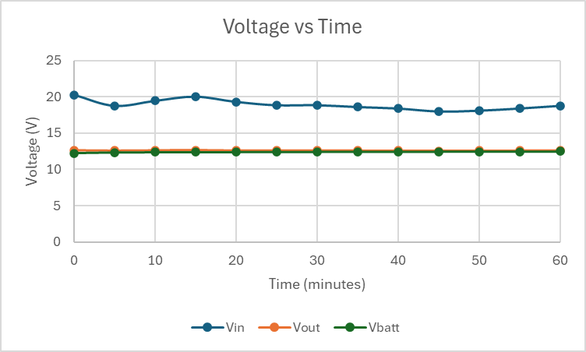
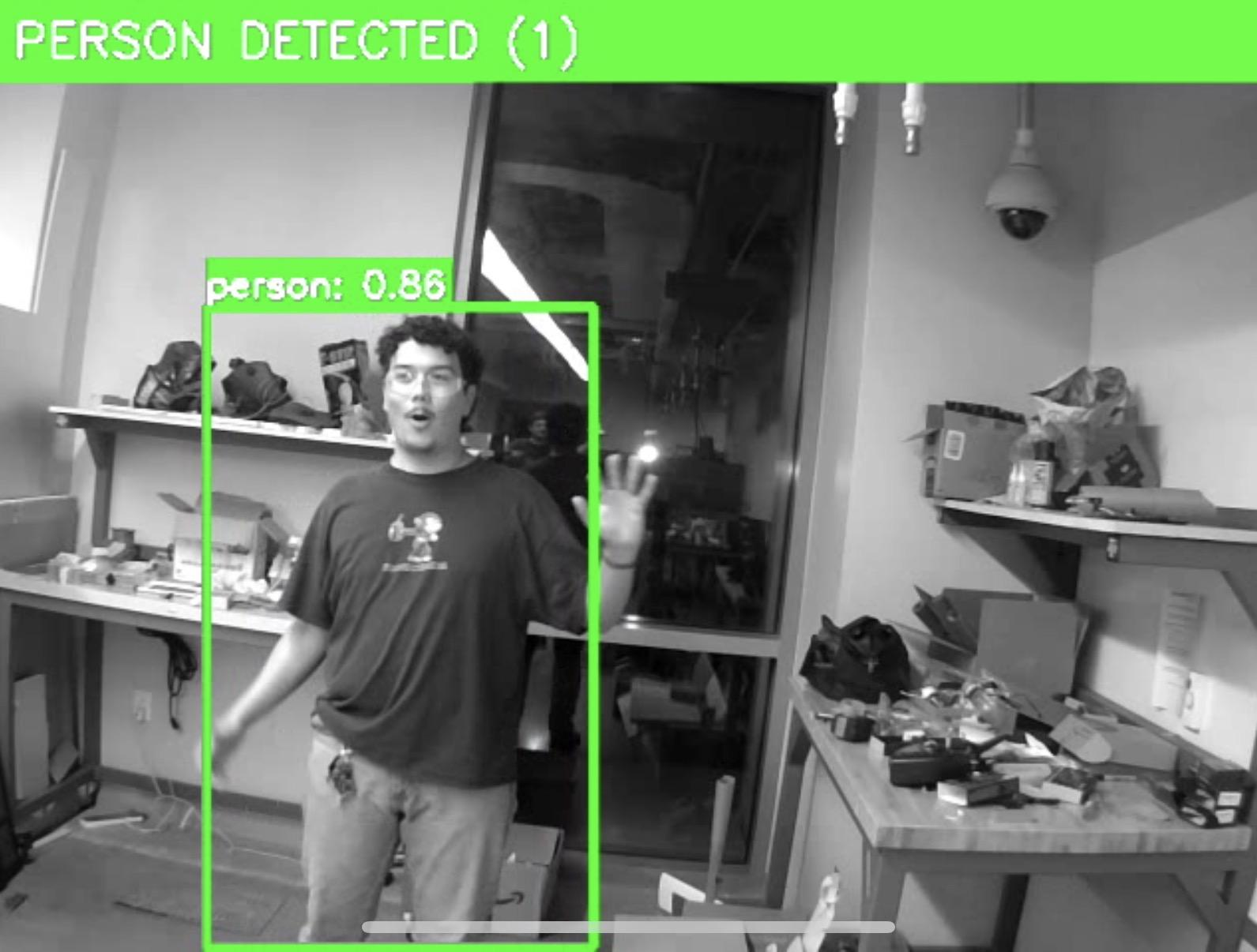
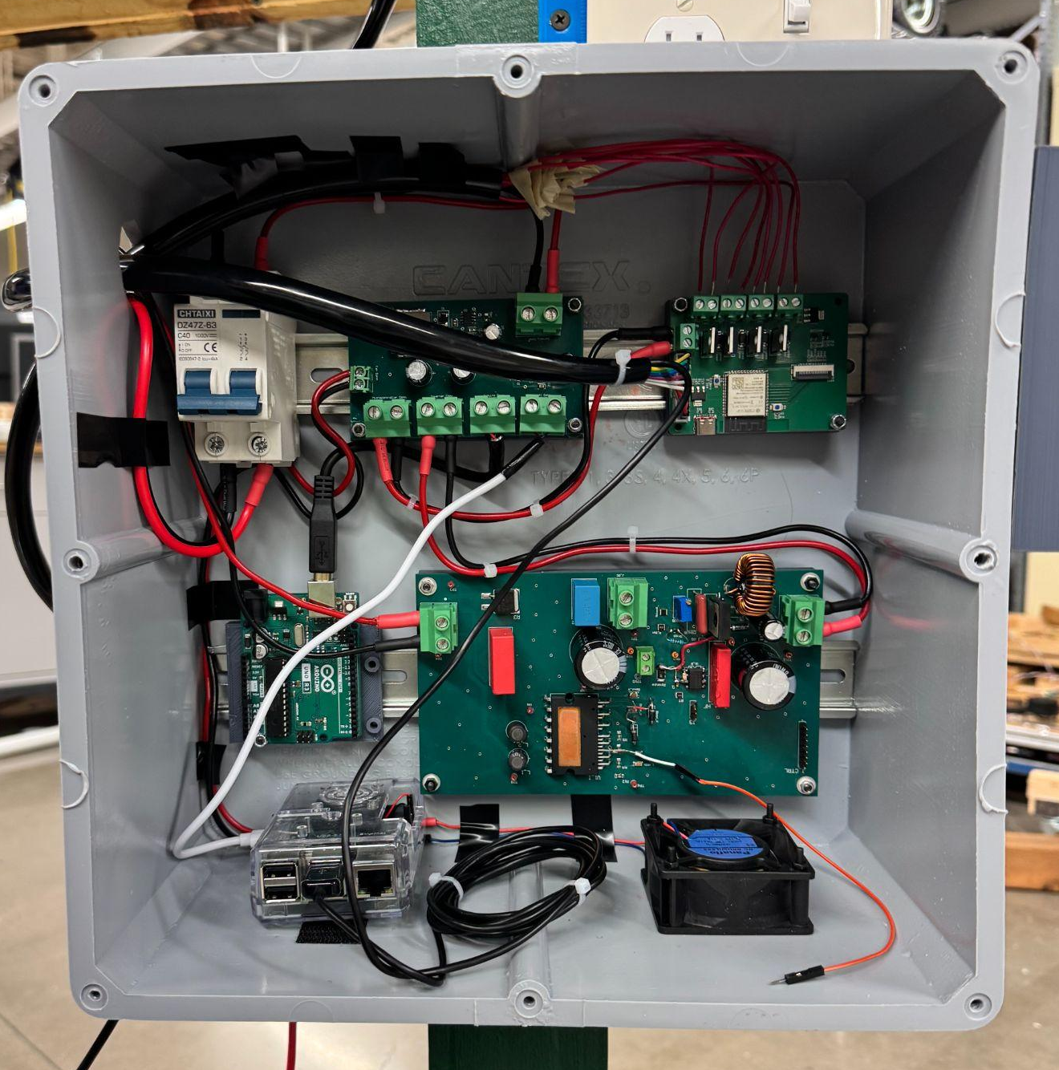
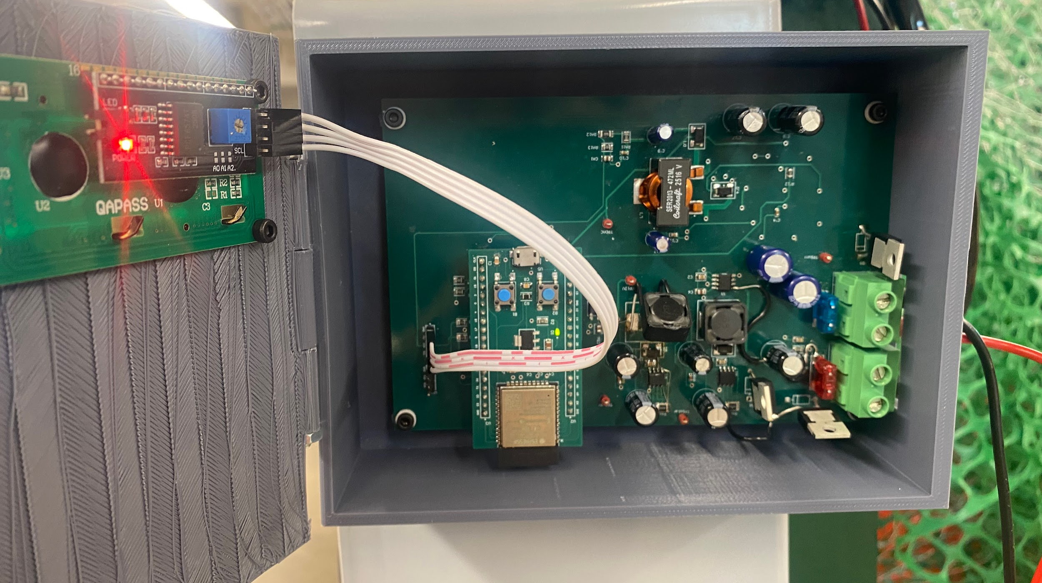
Solar Home Lighting 1
Matthew Cepulis, Corey Perlmutter, Thomas Moll, Sara Rueda
Professor Wonhyeok Jang
Problem Definition
Traditional residential lighting systems rely heavily on grid electricity, lack intelligent control features, and do not optimize for energy savings, especially for night-time usage when lighting demand is highest.
B
Methodology
For our project, we designed and prototyped a standalone Solar Home Lighting System that facilitates various functions. For power generation and storage, the system employs an MPPT Charge Controller to regulate the current from a solar panel to charge a 12V battery. The stored charge is then distributed to a handful of subsystems for use by the end-user, such as a 120VAC inverter for powering small electronics, a microcontroller for monitoring sensors and operating on-board lights, and a Raspberry Pi running low-light Human Detection. For monitoring and control, an app was designed that interfaces with the subsystem through a cloud database.
Figure 4. Boost Converter - Inverter Schematic
Figure 7. Lighting system
C
Figure 2. Integrated system
Engineering Analysis
The system was divided into different subsystems to simplify the design and ensure proper integration. Each subsystem handles a specific function and works together to achieve the overall system performance.
Solar panel and charge controller subsystem
DC/AC load subsystem
Microcontroller and sensor data subsystem
Mobile application and image processing subsystem
Figure 5. Sensor Control Schematic
Figure 8. Charging Data
Impact
Intelligent Autonomous Lighting: Sensors and AI detect motion and ambient light, turning lights on only when needed at night to reduce energy use.
Sustainable Off-Grid Power: Solar panels and battery storage allow the system to operate independently from the grid, providing reliable nighttime lighting.
Remote Monitoring and Control: A mobile app with cloud integration lets users monitor and control lighting in real time, with both manual and automatic modes.
D
Figure 6. Human Detection in action.
A
Outcomes
The Solar Home Lighting system successfully integrated four subsystems; solar charge control, DC/AC power conversion, microcontroller sensor fusion, and mobile app control, into a functional off-grid residential lighting platform. Together the subsystems demonstrate a deployable, grid-independent lighting solution that reduces energy waste through intelligent occupancy-based automation.
References
Morawski, I., Chen, Y. A., Lin, Y. S., & Hsu, W. H. (2021). Nod: Taking a closer look at detection under extreme low-light conditions with night object detection dataset. arXiv preprint arXiv:2110.10364.
Acknowledgements
We would like to thank our professors and teaching assistants for their guidance and support throughout this project, as well as Texas A&M University for providing the resources that made this work possible.
Figure 1. Integrated system
Figure 3. Charge Controller

